Slide 1
Basic Details of the Team and Problem Statement
SDG Goal : Quality Education
Problem Statement Title: ARQe (Augmented Reality based Quality Education
Team Name: The Last Uchiha

Slide 2
Idea/Approach Details
Describe your Problem Statement:
To create an app that lets educators and students create their own AR experiences by placing 3D models on reality.
It is not specific to any subject or grade, and can be used throughout various disciplines.
Mainly, to enhance learning of abilities like problem-solving, collaboration, Practical Knowledge, Visualization and creation to better prepare students for the future.
Additionally, Through NLP integrated model the Question bot finds solutions to the creative thinker’s questions.

Slide 3
Idea/Approach Details
Describe your Objectives:
Why Should AR Enter the Classroom?
Augmented reality offers new and exciting opportunities for learning, mostly because it allows students to see things that are not possible in reality.
You can bring dinosaurs into the class, explore 3D history models, and closely examine human anatomy.
AR technology has an ability to render objects that are hard to imagine and turn them into 3D models, thus making it easier to grasp the abstract and difficult content.
This is especially good for visual learners and practically anyone to translate theoretical material into a real concept.

Slide 4
Idea/Approach Details
Describe your Objectives:
How AI For All is Achieved?
The term AI simulation may also be applied to any machine that exhibits traits associated with a human mind such as learning and problem-solving.
Natural Language Processing (NLP) combines the power of linguistics and computer science to study the rules and structure of language, and create intelligent systems (run on machine learning and NLP algorithms) capable of understanding, analyzing, and extracting meaning from text and speech.
The integrated NLP model (The Question Bot) is an user interactive real-time model where the user’s experience and creative questions are answered through the feeded information intelligently.

Slide 5
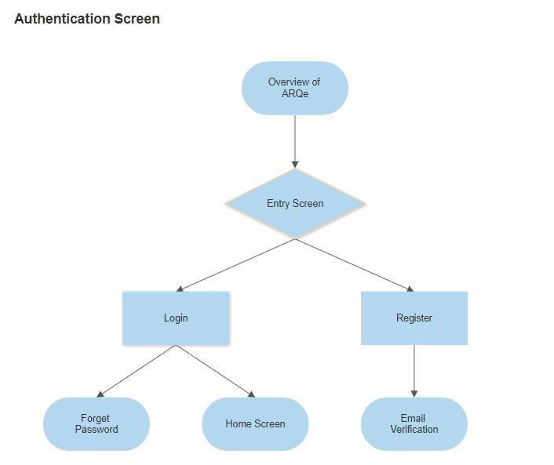
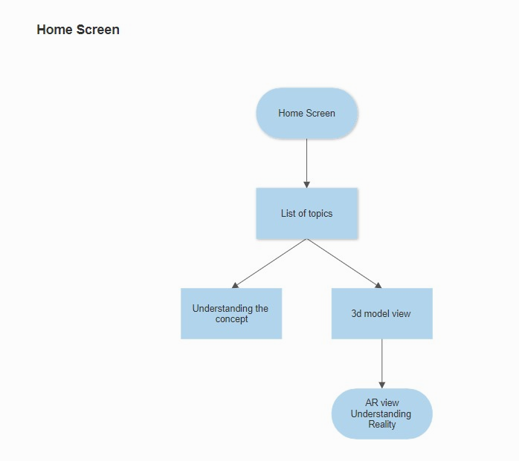
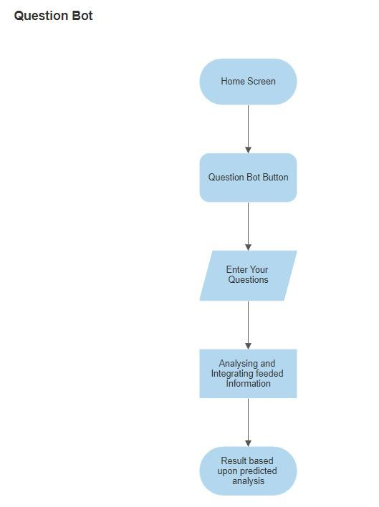
Idea/Approach Details
Describe your Work flow:

Slide 6
Idea/Approach Details
Describe your Work flow:
Authentication Screen: This screen contains Login and Register Buttons which take you to their respective screens. The Login Screen has two text fields Mail Id and Password, a Login button which checks the Firebase backend data for a registered user and redirects to the Home screen and a Forgot Password button which takes you to a new screen where you need to enter your mail id to receive a link to reset your password. The Register Screen has two text fields Mail Id and Password and a Register Button which creates a new entry in the Firebase authentication (FireAuth) and sends an verification mail to your account to confirm the entry.
Home Screen: This screen contains tiles of different topics with a Question Bot icon on the bottom right. Each topic tile consists of the information about that respective model and a Model View button at the bottom right which redirects to the 3D model page with a AR View button at the bottom right corner. The Model View Button loads the 3D model from Flask API backend and displays it The AR View Button opens the Google AR core module in the device and projects the digital visual elements of the respective model, which can also capture and record the projected model.
Question Bot: It is a pretrained model has two parameters context and questions. Context consists of information about the topics and the Question consists of questions based on the context. Context is a static data and Question will be sent as html form to the Model through flask api and the result will be sent from the api to display in the in the Question bot screen.

Slide 7







Idea/Approach Details
Tools & Technology used:

Slide 8
Idea/Approach Details
Describe your Use Cases here
Describe your Dependencies / Challenges here
Augmented reality in schools
Augmented reality in college
AR for distance learning
Augmented reality in work training
Medical Training
Design & Modeling
Business Logistics
Tourism Industry
Field Service
Entertainment Properties
Climatic Changes
Home Decor
Gaming
Realtime Transportation
Proper hardware is needed: AR aided mobile phones are quite expensive and normal android phones of lesser specifications do not support AR.
Limited content : Creating augmented reality content to promote businesses can be extremely complex and expensive.
Lack of regulations : Currently, there are no regulations to govern the usage of augmented reality.
Public skepticism : Consumers are unaware of the benefits and applications of augmented reality.
Physical safety risks : Augmented reality applications can be immensely distracting and may lead to physical injuries

Slide 9
Uniqueness of The Solution
Elaborate on the Novelty/Innovativeness of the idea in the chosen problem area.
Most of students from their travel of education from primary to secondary have comparatively reduced enthusiasm and devotion on their academics its due to the fear and failure that grows amongst the students about their future. This tends in reducing the literacy of creative thinking and curiosity questioning. Integrating technology in the growth of the students education can enhance their way of visualising themselves better.
The pandemic is quickly demonstrating why online education should be a vital part of teaching and learning. Teachers can harness online learning as a powerful educational tool. Real Time visualization of various subjects like Mathematics, Science, Architecture and Space can make learning more interesting than understanding through text by imagination.
Our App ARQe mainly focuses that lets educators and students create their own AR experiences by placing 3D models on reality. It is not specific to any subject or grade, and can be used throughout various disciplines. Additionally, Through NLP integrated model the Question bot finds solutions to the creative thinker’s questions. Our app has various applied concepts of different fields and current updates. Normal, Android users can access the AR models created with the featured specs of mobile. As result, while visualising the models they can be captured or recorded too

Slide 10
Impact and scalability
How easy will it be to adapt the solution especially with regards to meeting the growth and demand in the impacted area?
Augmented reality technology has proven to be one of the top innovations opening up new growth points for businesses around the world. Analysts predict that the AR market will reach $198 billion in 2025. This year, the number of mobile AR users is expected to reach 3.5 billion. With a large market to tap into, providing AR experiences can be a competitive edge in many industries. The improving technology also stands to allow for greater efficiency in the workplace.
ARQe was mainly developed with the insight to promote education to the next level where growth and demand in making models into more reality achieving low cost and high effective user-friendly app. ARQe mainly focuses on achieving growth in all the SDG platforms to increase the scale of Technology. Artificial intelligence with visualization integrated inside the app gives it the way where the solutions to the curiosity and creativeness of students can be achieved.
Our app mainly focuses on increasing the scale to various other industries like Powering Indoor and Outdoor Navigation, Combining with machine learning algorithms for an efficient option for disease detection, Augmented Reality Shopping Experiences, Virtual Manuals, Augmented Reality in Automotive Industries, AR Glasses, he Metaverse, Live Events, and Social Upheaval.
1
2

Slide 11
Demonstration Video
https://drive.google.com/file/d/1kAoO_V-yrfLL0c9qitIiYnZYvUMh7GQw/view?usp=sharing

Slide 12
THANK YOU

